Slide 1
Bible Study
How to Study the Bible:
Methodology and Useful Tools
Justin Henderson

Slide 2
About Me
Co-Founder of H & A Security Solutions / Tellaro ™
Cyber Security Enthusiast
Husband and Father
Lover of Christ

Slide 3
Disclaimer
“Scripture quotations are from the ESV® Bible (The Holy Bible, English Standard Version®), © 2001 by Crossway, a publishing ministry of Good News Publishers. ESV Text Edition: 2025. The ESV text may not be quoted in any publication made available to the public by a Creative Commons license. The ESV may not be translated in whole or in part into any other language. Used by permission. All rights reserved.”

Slide 4
Action Items
The goal of this talk is to help you:
Understand the motives for studying the Bible
Apply a simple methodology that provides a deeper level of study while remaining simplistic and repeatable
Learn about tools and resources helpful in study
Take discipleship to a new level

Slide 5
What is Discipleship
Process of learning to love and follow Jesus and becoming more like him in our attitudes and actions
And seeking/making others who want to do the same thing
John 8:31–32 (ESV)
So Jesus said to the Jews who had believed in him, “If you abide in my word, you are truly my disciples, and you will know the truth, and the truth will set you free.”
Luke 9:23 (ESV)
And he said to all, “If anyone would come after me, let him deny himself and take up his cross daily and follow me.”

Slide 6
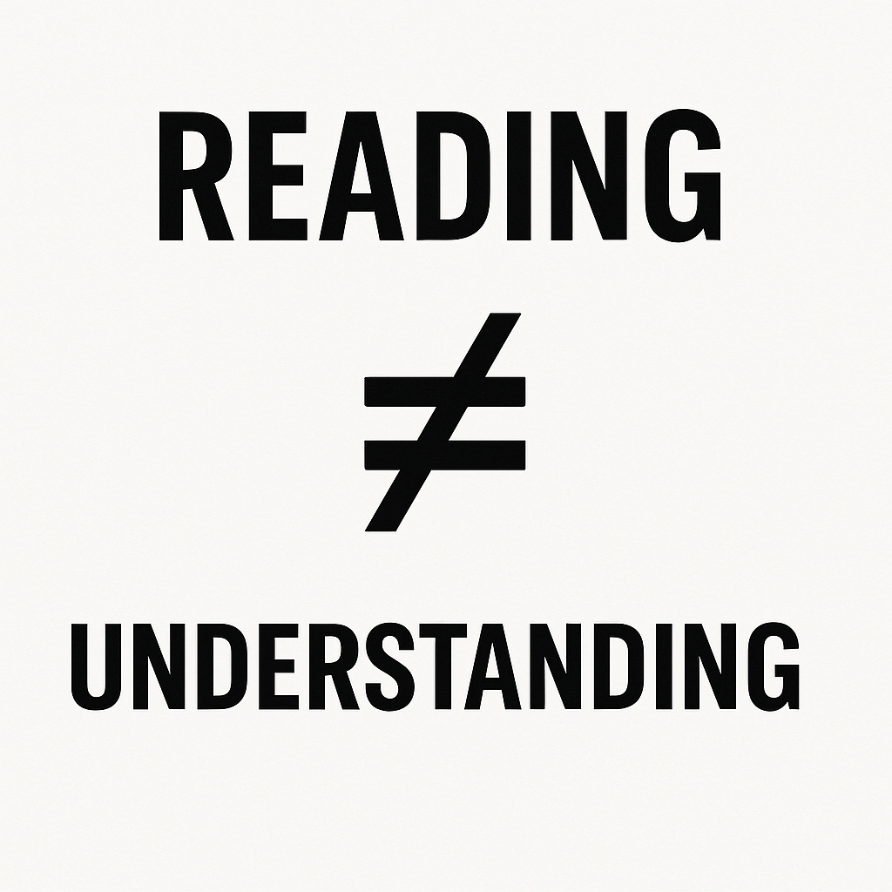
Why Study the Bible?
God reveals Himself through His Word
Scripture is the foundation for Christian living
Discipleship requires understanding, not assumptions
The goal is transformation, not information
Spiritual depth requires intentional study
Psalm 119:105 (ESV)
Your word is a lamp for my feet and a light
on my path

Slide 7
Why a Method Matters
"Reading" alone often becomes shallow
We jump to application without understanding
We impose our ideas onto Scripture
We miss cultural, historical, and literary context
  And the books of the bible do not conform to modern literary styles
  Things are not always chronological
  Passages may be written with a focus alien to expectations

Slide 8
Studying Together
Studying alone is good…
…But as a group is powerful
Builds personal discipline
Deepens your individual relationship with God
Helps you learn to hear God’s voice
Allows focused, quiet meditation
Others see perspectives, details, and connections you might miss
Shared insights sharpen your understanding
Community encourages honest questions
Together + Alone = Healthy, Balanced Spiritual Growth

Slide 9
Introducing SOMA
S - Scripture
O - Observation
M - Meaning
A - Application

Slide 10
S - Scripture
Select a text. Commit to a short section
For example: Mark 1:1-8
Read the selected text at least two times and read for understanding. The goal is not to get through it, but to understand it
Now read it one more time – as you read, imagine yourself as different characters in the store or as an observer
* It can be helpful to read as if you have never read the section before

Slide 11

O - Observation
All about asking questions
As many as you can. Be curious
But don’t focus on answering, yet…
Examples:
Why did Jesus say that to this audience?
Who is that guy mentioned in this passage?
What does that word mean?
Why would they have gone to this destination?
Is what God is proclaiming here overly harsh?

Slide 12
Mark 1:1-8 ESV
1 The beginning of the gospel of Jesus Christ, the Son of God. 2 As it is written in Isaiah the prophet, "Behold, I send my messenger before your face, who will prepare your way, 3 the voice of one crying in the wilderness: 'Prepare the way of the Lord, make his paths straight,'"4 John appeared, baptizing in the wilderness and proclaiming a baptism of repentance for the forgiveness of sins. 5 And all the country of Judea and all Jerusalem were going out to him and were being baptized by him in the river Jordan, confessing their sins. 6 Now John was clothed with camel's hair and wore a leather belt around his waist and ate locusts and wild honey. 7 And he preached, saying, "After me comes he who is mightier than I, the strap of whose sandals I am not worthy to stoop down and untie. 8 I have baptized you with water, but he will baptize you with the Holy Spirit."

Slide 13
M - Meaning
Foundational principle
“Scripture can never mean what it never meant”
Meaning is not invented – it is discovered
Seek the author’s intended message, not our personal interpretation
Now is where you attempt to answer your questions

Slide 14
Tools for Understanding
Footnotes in a study Bible
Scripture cross-references
Multiple translations
Maps
Historical background
Context within chapter
Context within the book
Reliable commentaries
Original language analysis
Online Bible Tools
Logos
Blue Letter Bible
*Other Online Tools
Blogs
Videos
AI (ChatGPT, etc.)
* Beware invalid information

Slide 15
Establish Meaning
Return to your observations and:
Find answers
Consider cultural background
Consider genre and literary style
Look for repeated themes
Then, summarize the meaning of the passage in your own words
Be objective

Slide 16
Example AI Prompts
In Mark 1:1–8, are there key words or ideas whose meaning isn’t fully captured in modern English?
What would the original audience have understood here that I might miss today?
Why did the author include these specific details, and what is he emphasizing?
What Old Testament passages or themes does this connect to?
Provide sources for the questions so I can confirm accuracy

Slide 17
A - Application
Application poses the question:
“What does this mean for me, not what does it mean to me?”
Application flows from meaning, not emotion

Slide 18
Transformation Over Information
The Word aims for:
A changed heart
Renewed mind
Spirit-led obedience
Growing Christlikeness
Respond with prayer, praise, repentance, and trust
Discipleship begins where application ends

Slide 19
Saturation of the Word in Daily Life
Read, listen, or watch something related to the text being studied during the week
Journal something related to the text
Hold at least one conversation with someone concerning the text
Pray concerning the text – praise and petition

Slide 20
Three Directions of Application
Inward – How should this reshape my thoughts, desires, and/or attitudes
Outward – How should this reshape my actions, words, habits, and/or relationships
Upward – How should this reshape my trust, view of God, worship, and/or obedience?

Slide 21
Way of Discipleship – Done Together
Consider starting a SOMA group
Two weeks a section
First week (SO) and second week (MA)
Other resources:
Podcast for each section:
https://shows.acast.com/the-soma-podcast/episodes
Follow up classes: Interest in AI or Original Language?

Slide 22

Closing
Psalm 1:1–2 (ESV)
Blessed is the man who walks not in the counsel of the wicked, nor stands in the way of sinners, nor sits in the seat of scoffers; but his delight is in the law of the LORD, and on his law he meditates day and night.
justin@tellaro.io
Link to presentation

